Slide 1

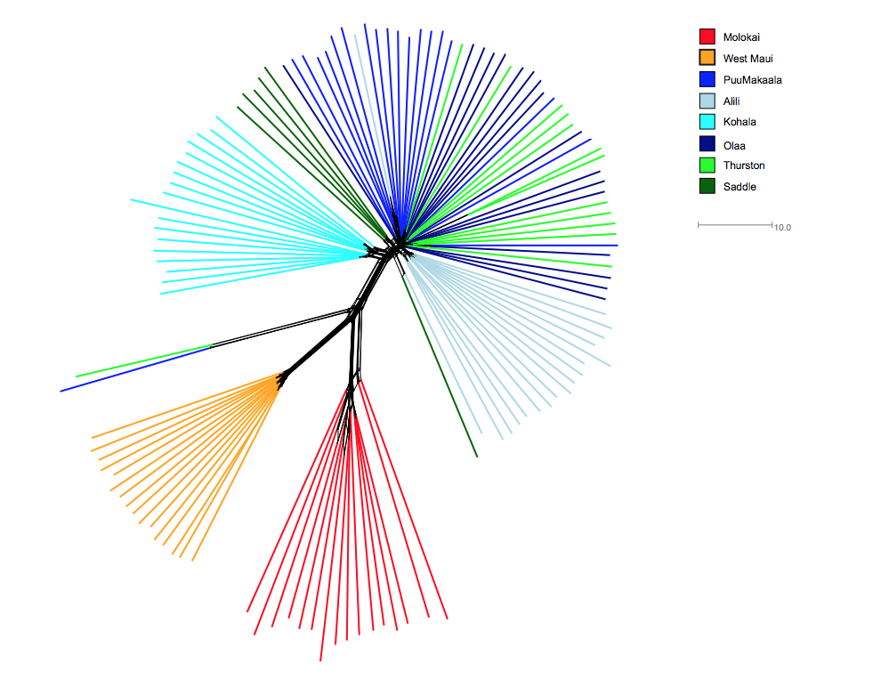
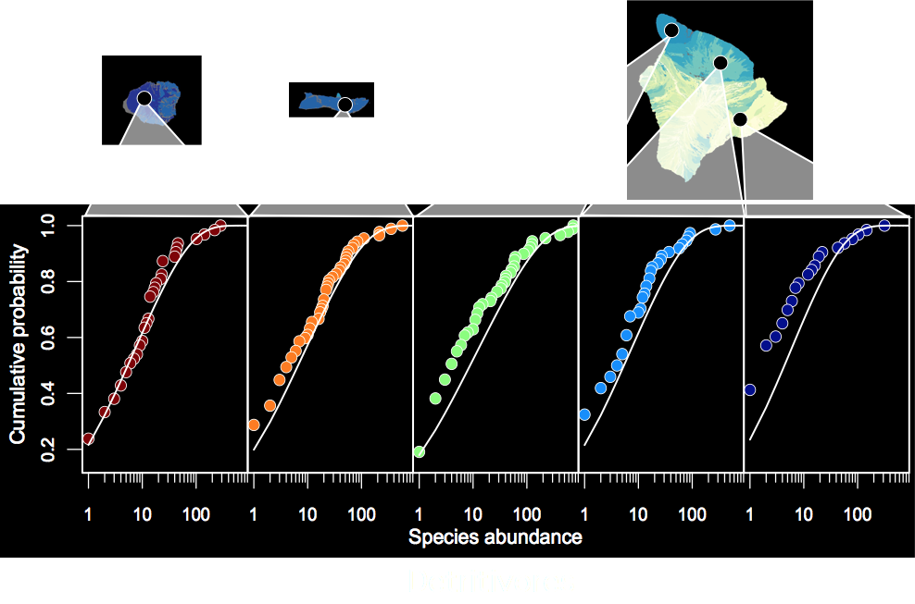
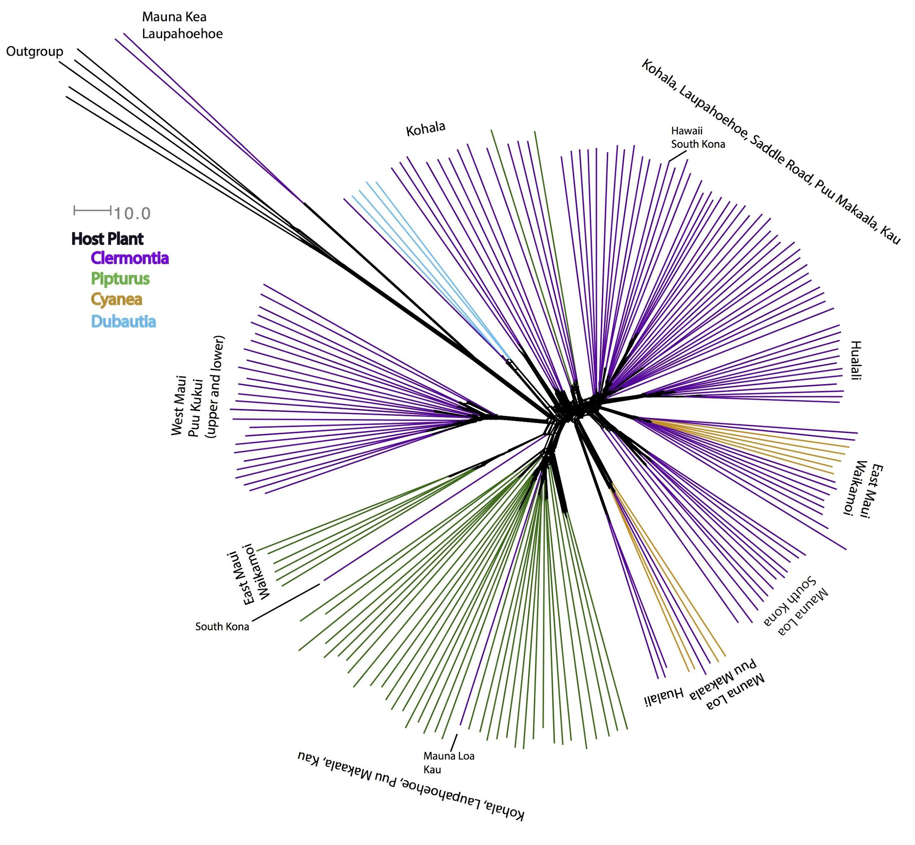
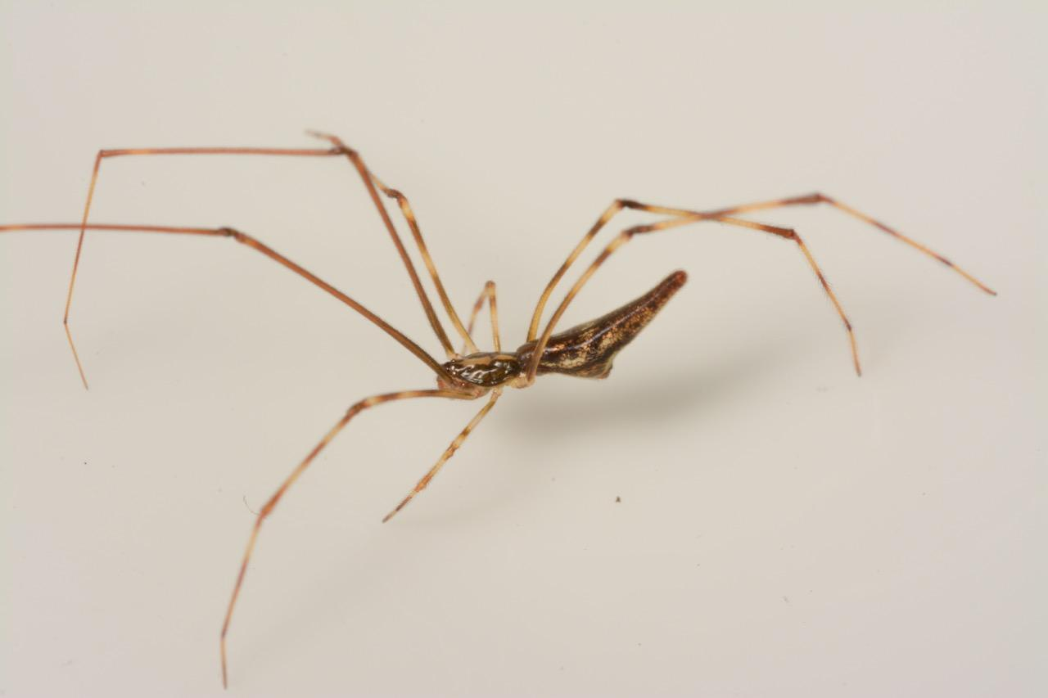
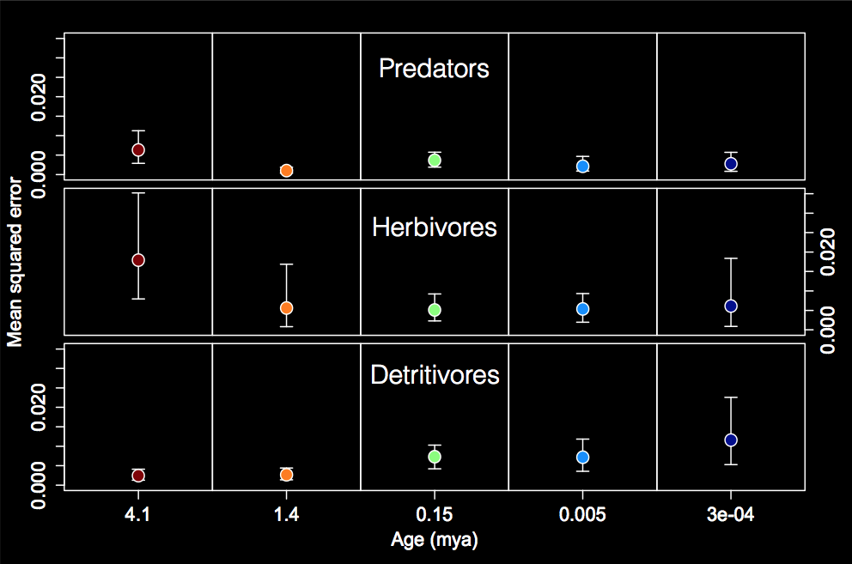




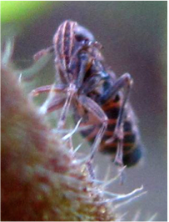








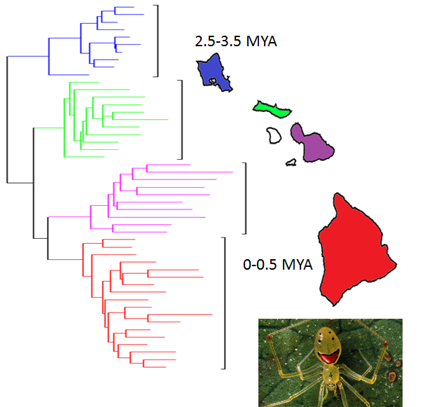
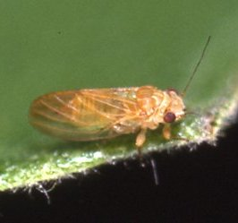
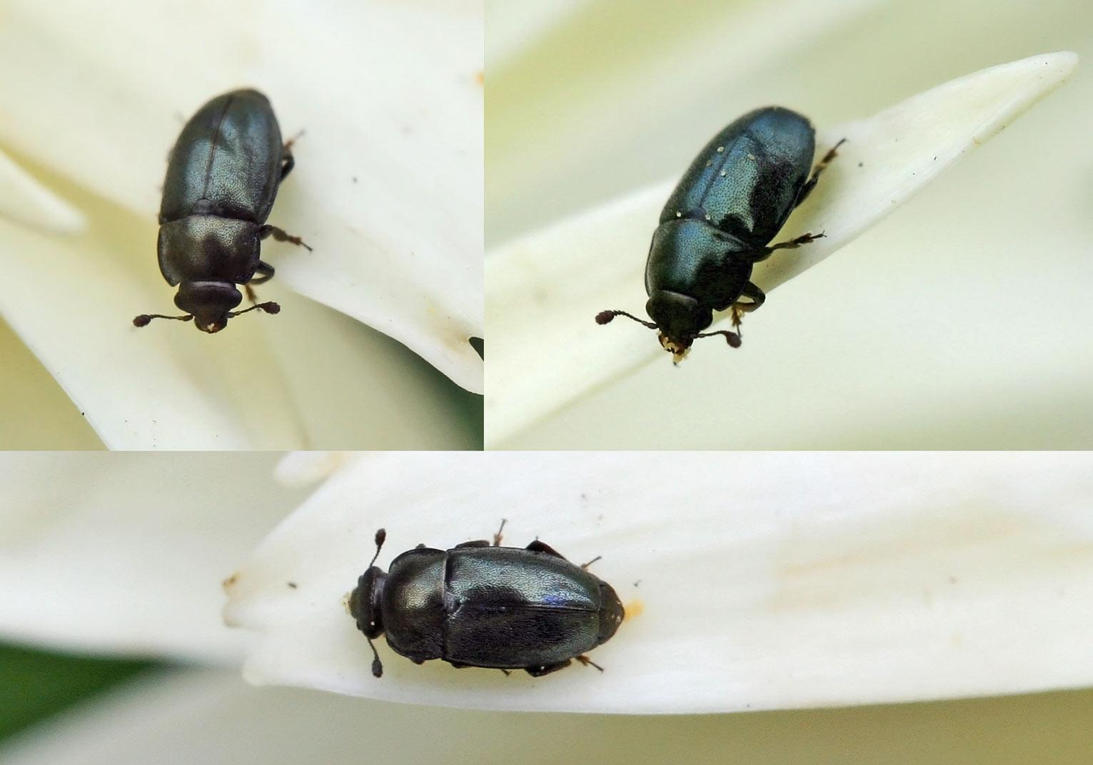
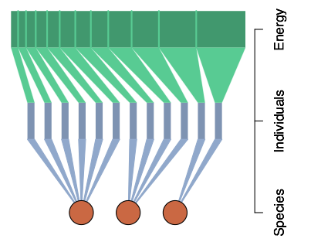
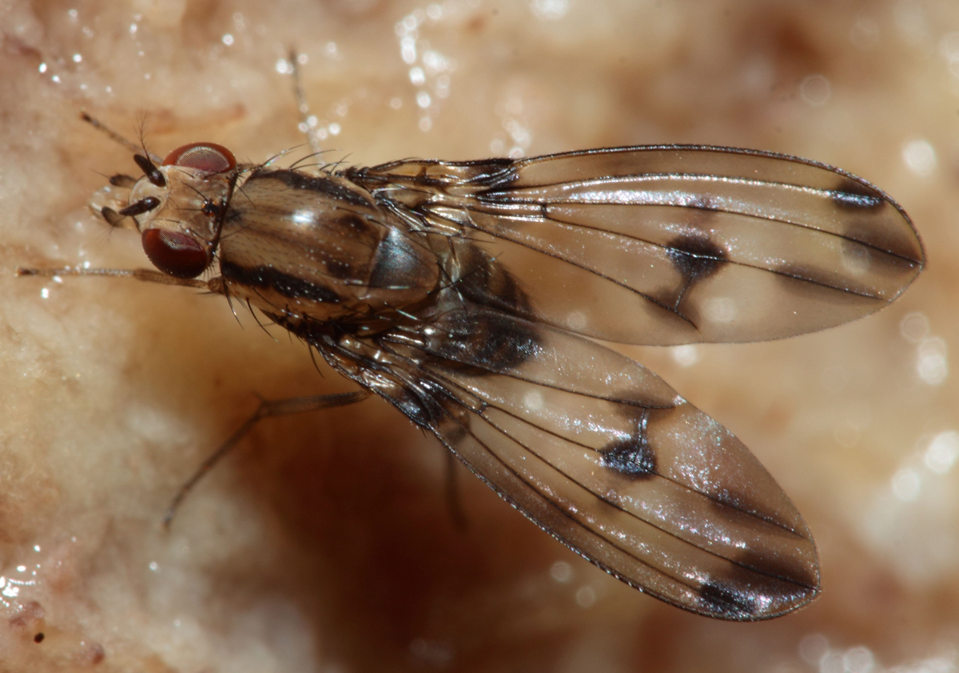
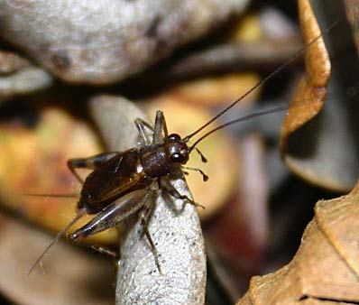
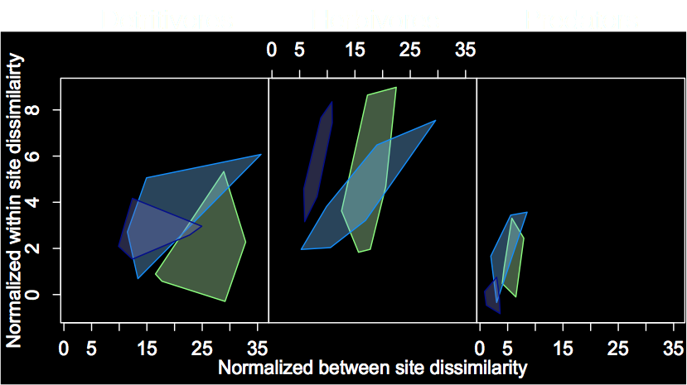
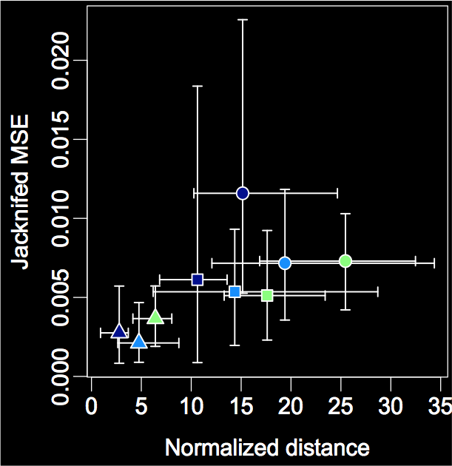
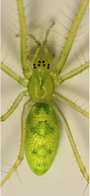
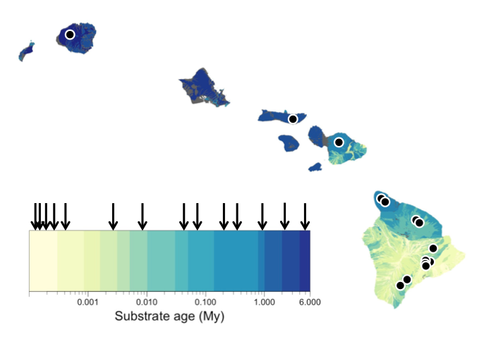
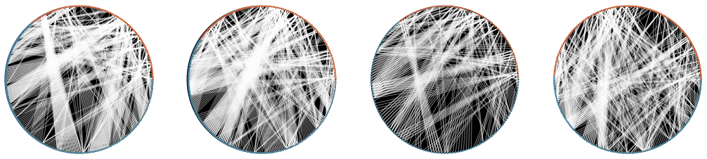
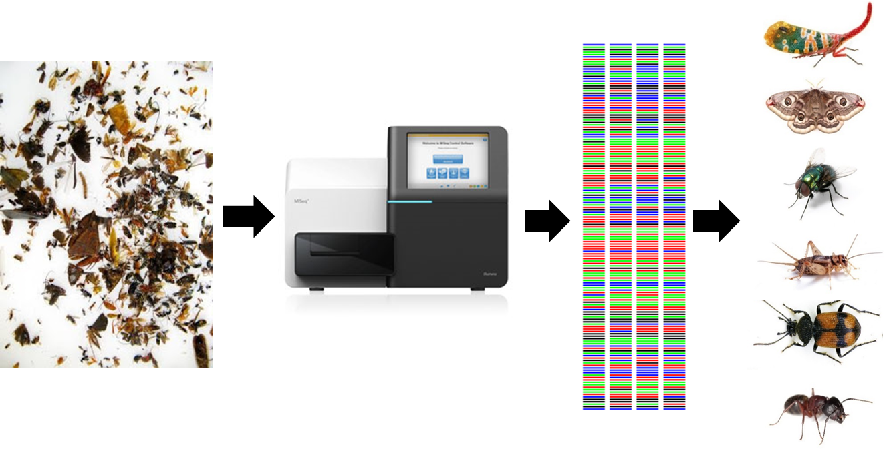
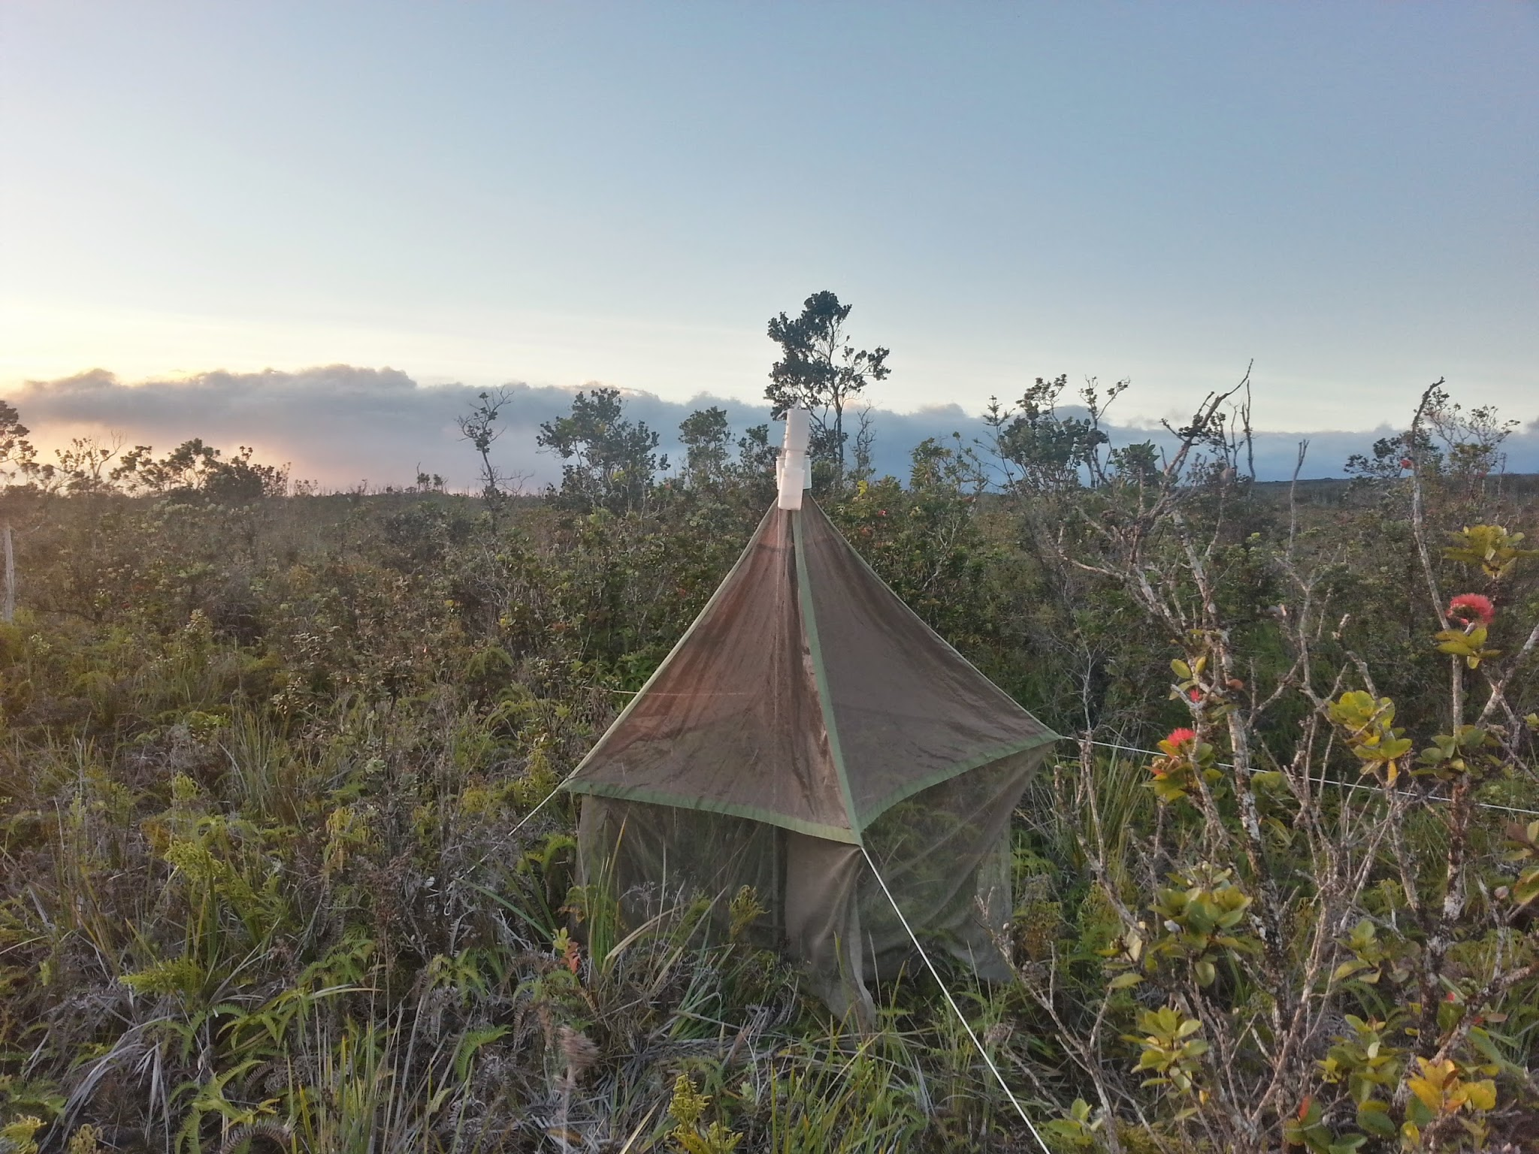
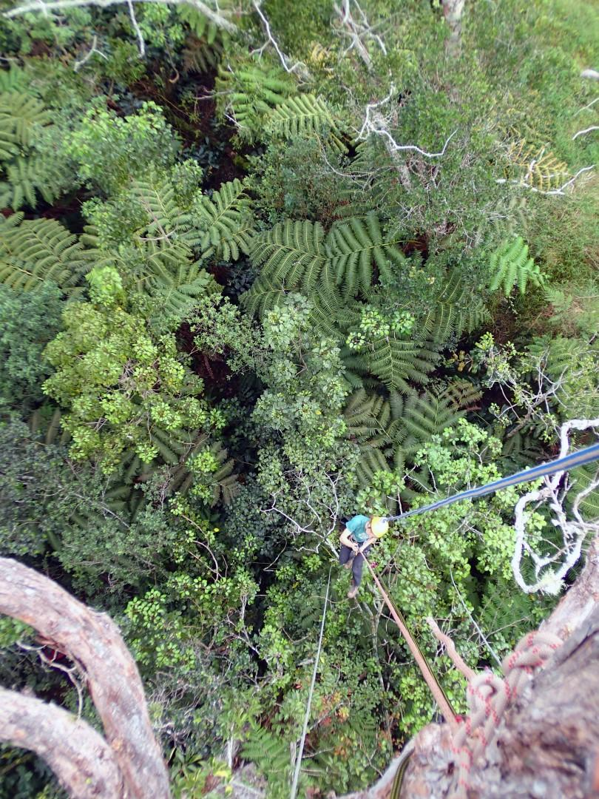
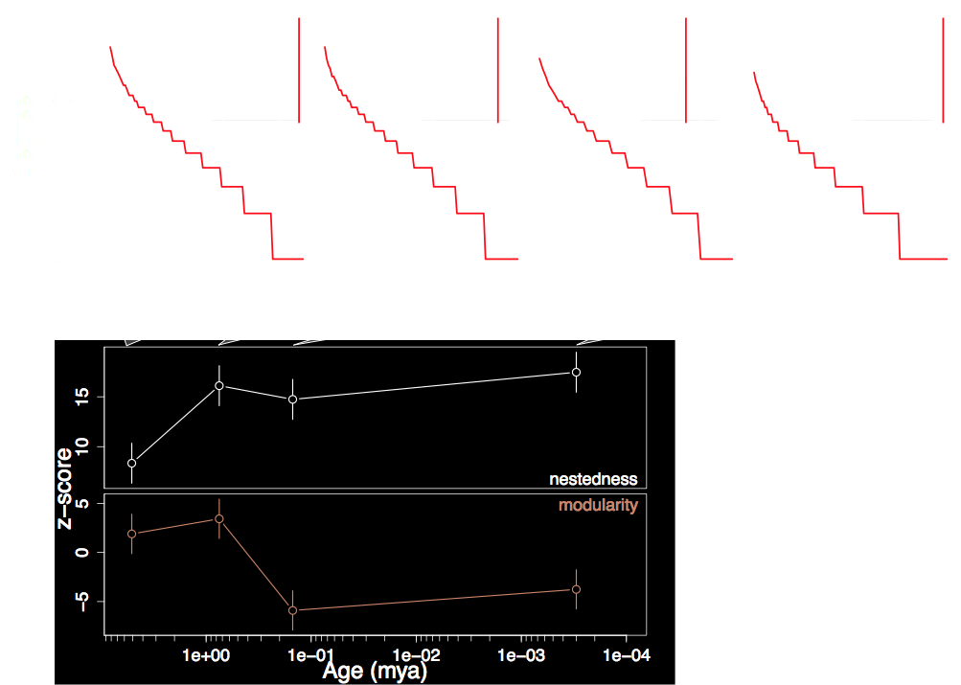
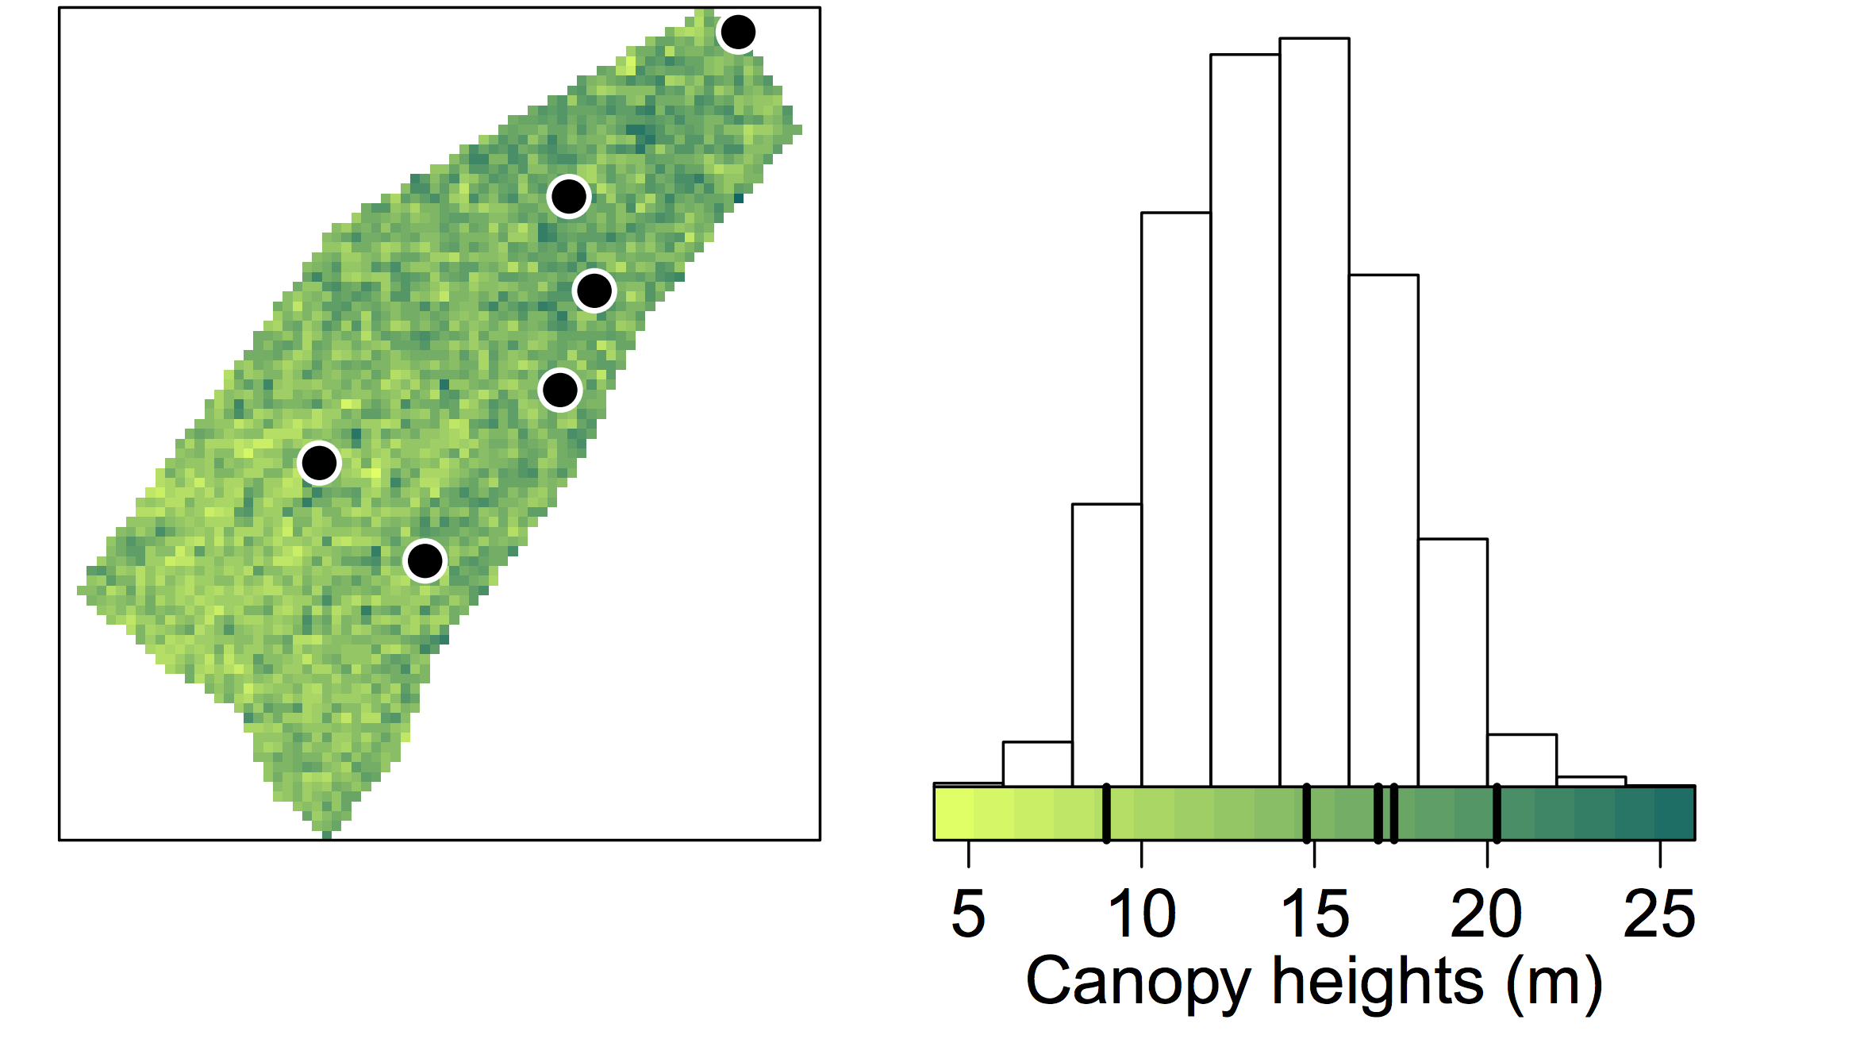
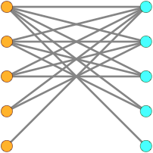
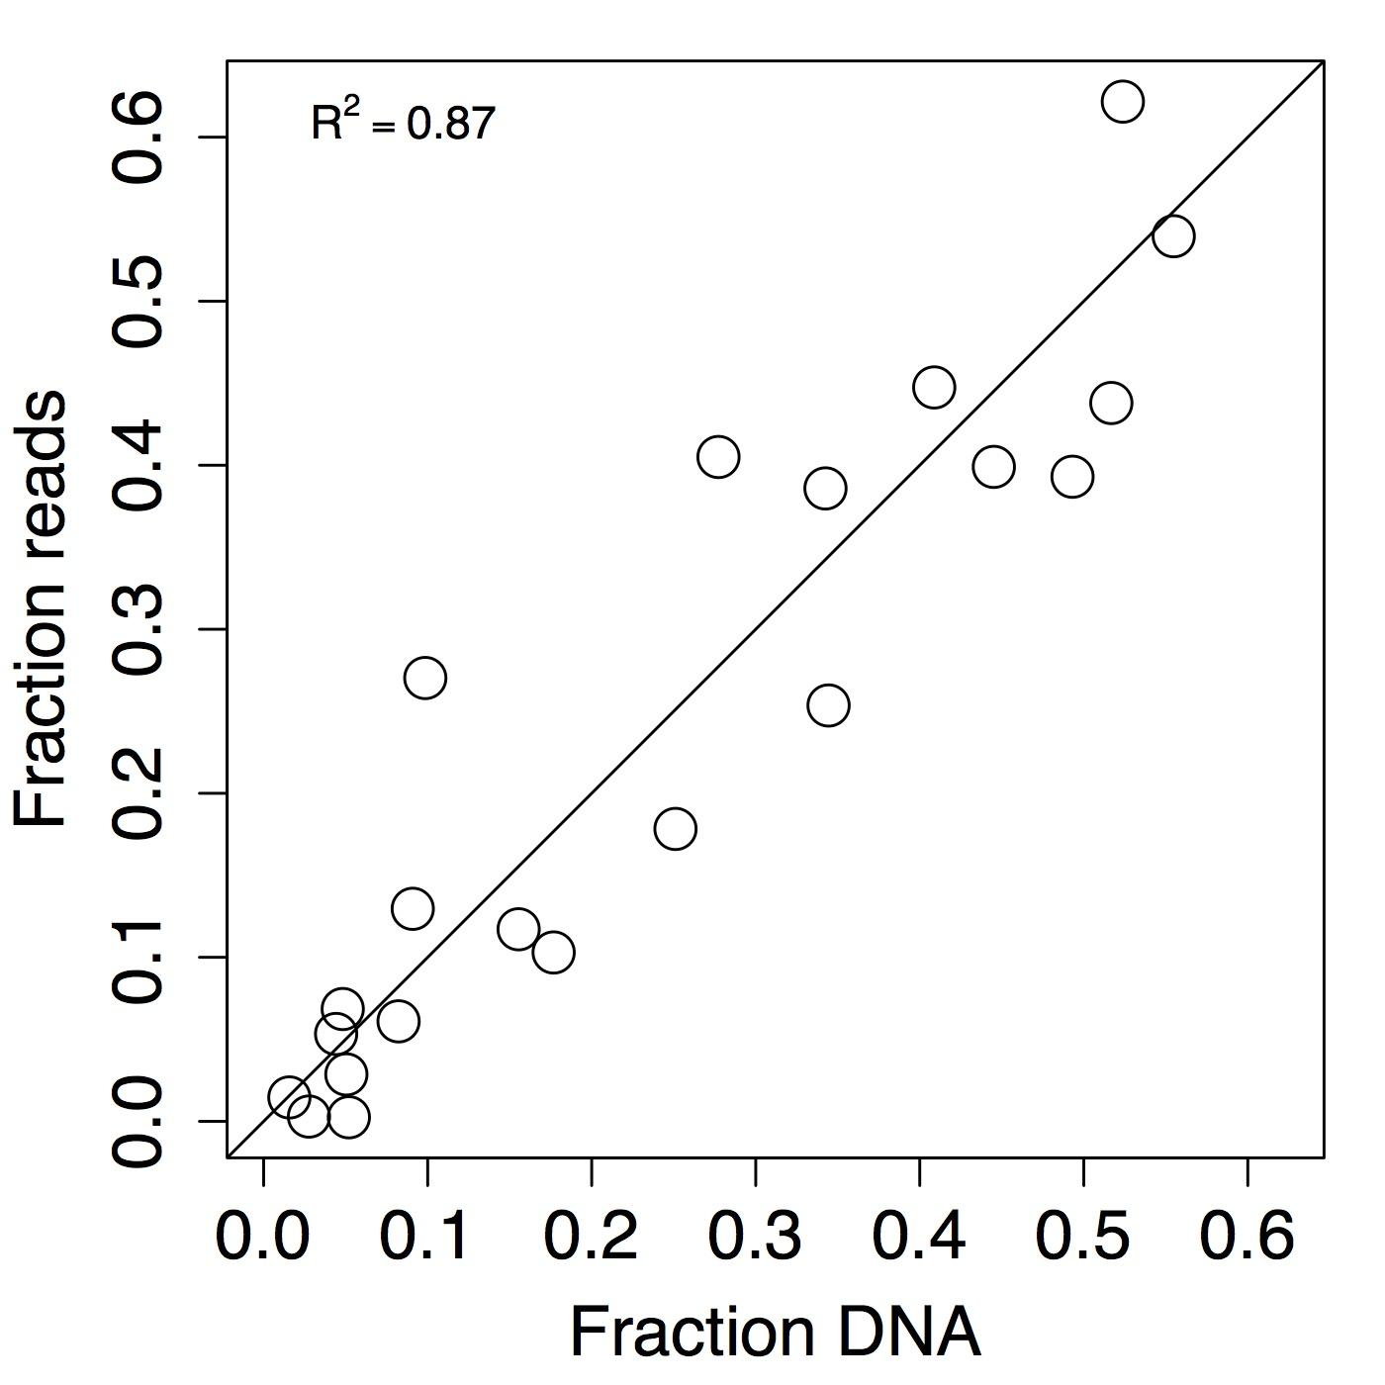
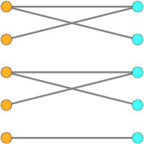
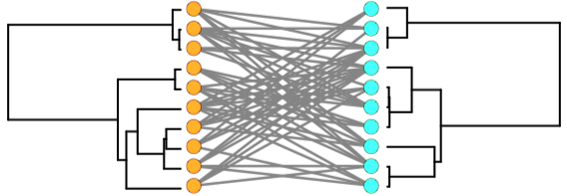
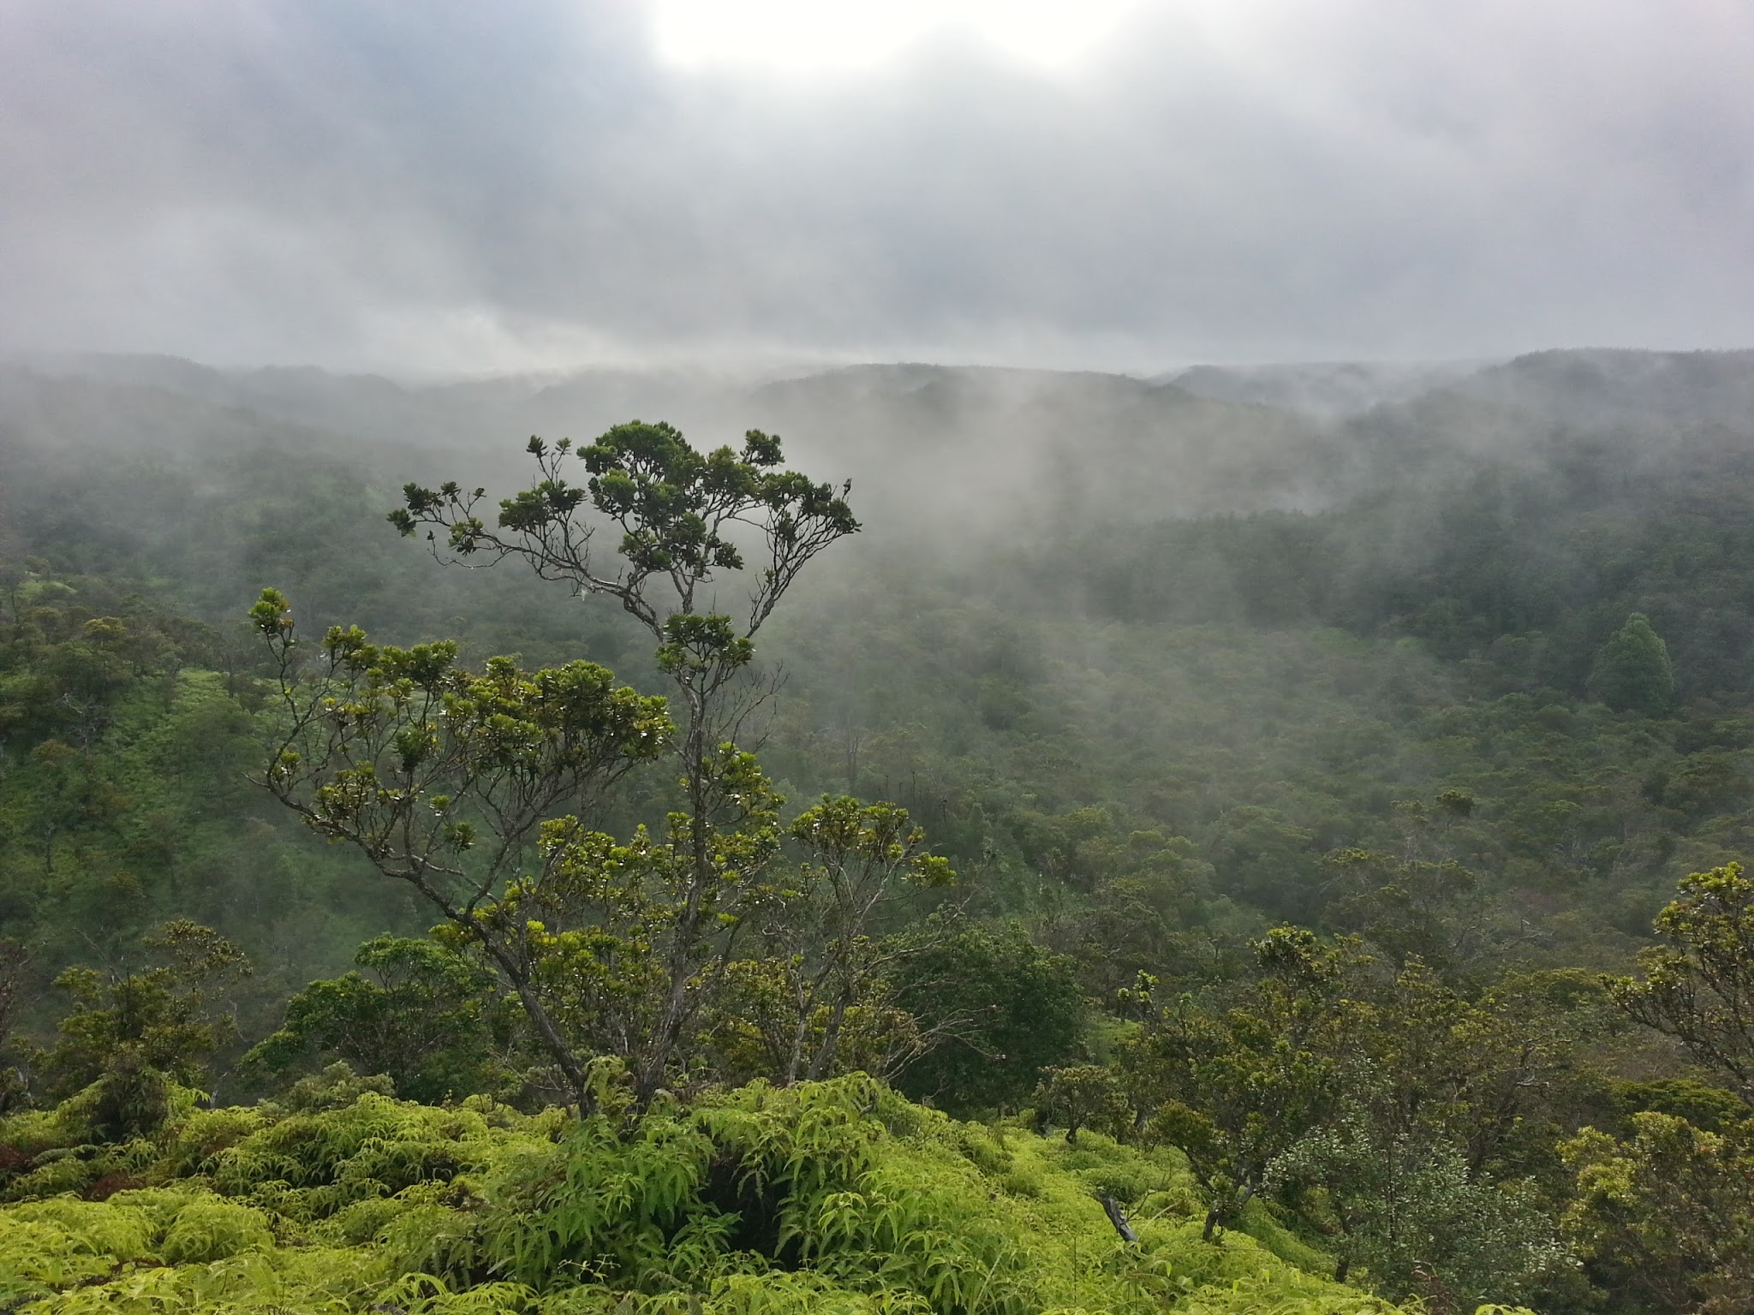
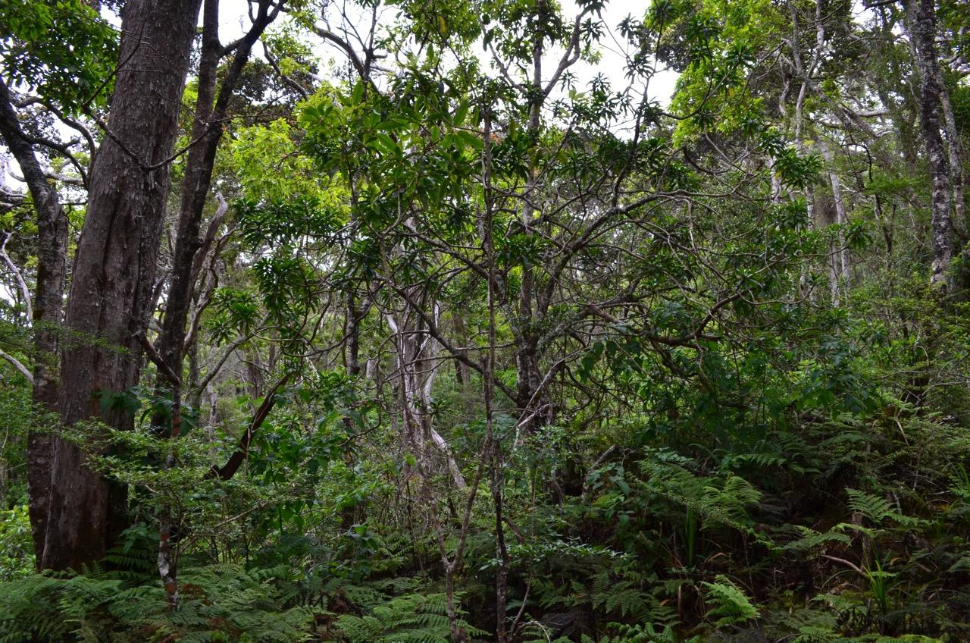
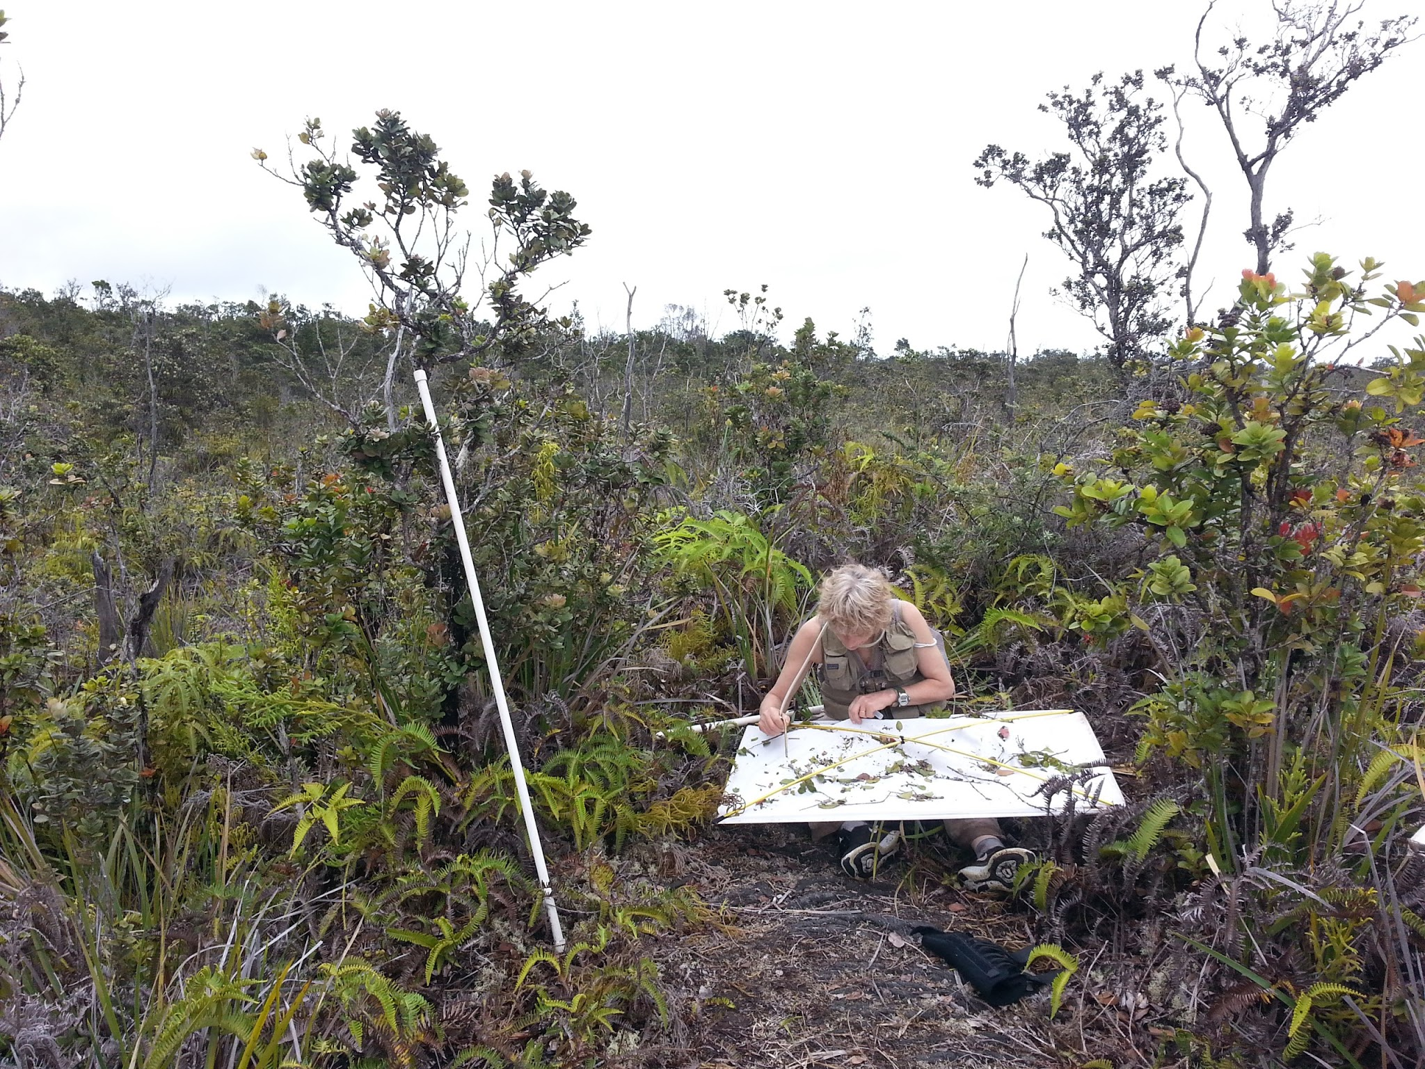
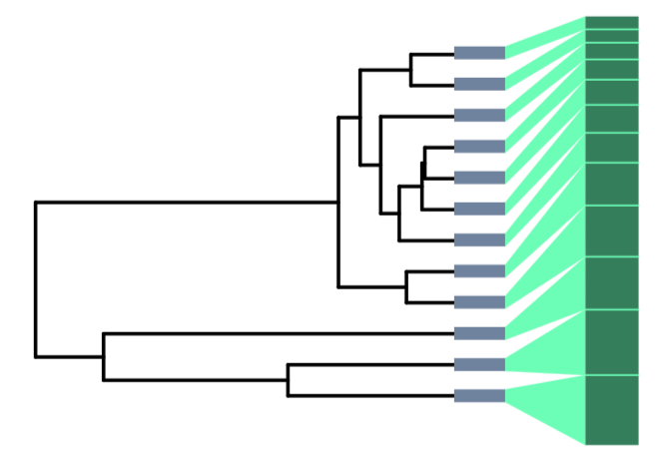
Integrating Ecology and Evolution Using the Dynamic Landscape of Hawaii
Population Genomics
Community Structure
Different trophic groups show different patterns of deviation from maximum entropy theory with respect to substrate age.
Andy Rominger, Jun Ying Lim, Henrik Krehenwinkel, Ellie Armstrong, Greg Asner, Gordon Bennett, Cerise Chen, Darko Cotoras, Curtis Ewing, Kari Goodman, Natalie Graham, John Harte, Tyler Linderoth, Jon Lambert, Neo Martinez, Rasmus Nielsen, Patrick O'Grady, Diana Percy, Don Price, Stefan Prost, George Roderick, Kerry Shaw, Monica Sheffer, Madeline Stark, Elske Tielens, Elliot Thompson & Fernanda Valdovinos, Rosemary Gillespie & Daniel Gruner
Ariamnes spiders
With data from PI Gruner’s study (2007 Biol. J. Linn. Soc.), we see that herbivores deviate from theory most at young and old sites, consistent with foodweb analyses.
Splits trees, estimated from exon capture and RAD data, showing population divergence based on geography and ecological interactions.
Nesosydne planthoppers
Understanding the origins of biodiversity requires disentangling the influence of evolutionary/historical processes from ecological processes. What makes this difficult is that ecological and evolutionary processes form a spatiotemporal continuum; while we can observe and test local ecological phenomena, we must infer past evolutionary processes from current observations. Remote island archipelagoes, in particular those with well defined chronologies, provide an opportunity to synthesize ecology and evolution. We use the Hawaiian Archipelago as a natural experiment to address a fundamental question in biodiversity—how do ecological processes (e.g. colonization and ecological fitting) interact to give rise to larger and longer term processes of adaptation and species diversification?
Focal lineages
Theory
Psyllids
Nitidulid beetles
In the youngest sites beta- diversity is correlated with deviation from theory
Laupala
crickets
Drosophila
Theridion grallator
Tetragnatha spiders
Understand diversity using maximum entropy theory
Capturing population divergence
How does the evolutionary history of biotas influence their contemporary ecological equilibrium?
Field sites
Food webs
Metabarcoding
Biodiversity sampling
Arthropod sampling in the canopy
Next steps: exhaustive
biodiversity assessment
Standardized sampling across the chronosequence
Sites were selected to represent the chronosequence, but constrained to similar elevation and precipitation.
High throughput ecology
Within sites, we used Carnegie Airborne Observatory data to select six random replicate plots, stratified with respect to canopy heights
Nestedness describes the degree to which specialists preferentially interact with generalists
Next generation sequencing based taxonomy, species abundance estimates and gut content analysis of consumers
Modularity describes the degree to autonomous sub-networks dominate the structure
With these approaches we can evaluate the phylogenetic structure of all ecological patterns
Koke’e, Kauai
Saddle, Big Island
Patterns in degree distributions of herbivorous hemipterans across sites show that networks deviate most from maximum entropy predictions on youngest and oldest sites. The trade-off between early immigration and later co-diversification is consistent with the maximum entropy analysis showing that the middle-aged site is in equilibrium.
Experiment to evaluate recovery of abundance from sequence data
Waikamoi, Maui
We would like to thank the National Science Foundation for making this work possible, as well as the dedicated land managers in Hawaii.

